Slide 1
Selling is where it all begins
The lifeblood of our business
Bryan Mangum

Slide 2
Why are you in sales?
What does it mean to be in sales?

Slide 3
Do you have Xtreme Ownership?

Slide 4
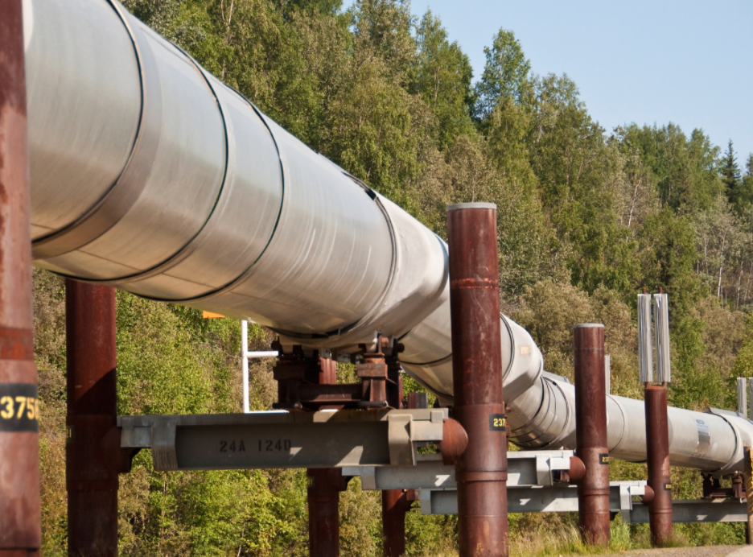
are you going to hit your number this year?
Achieving goals
#1 reason for not hitting number
Pipeline is empty
What is in your pipeline?
Types of accounts
Categorical focus
Account expansion
Are you taking ownership of key opportunities?
Start to finish
Devil is in the details
Transition plan
Leave nothing to chance

Slide 5
Fanatical Prospecting
Jeb Blount

Slide 6
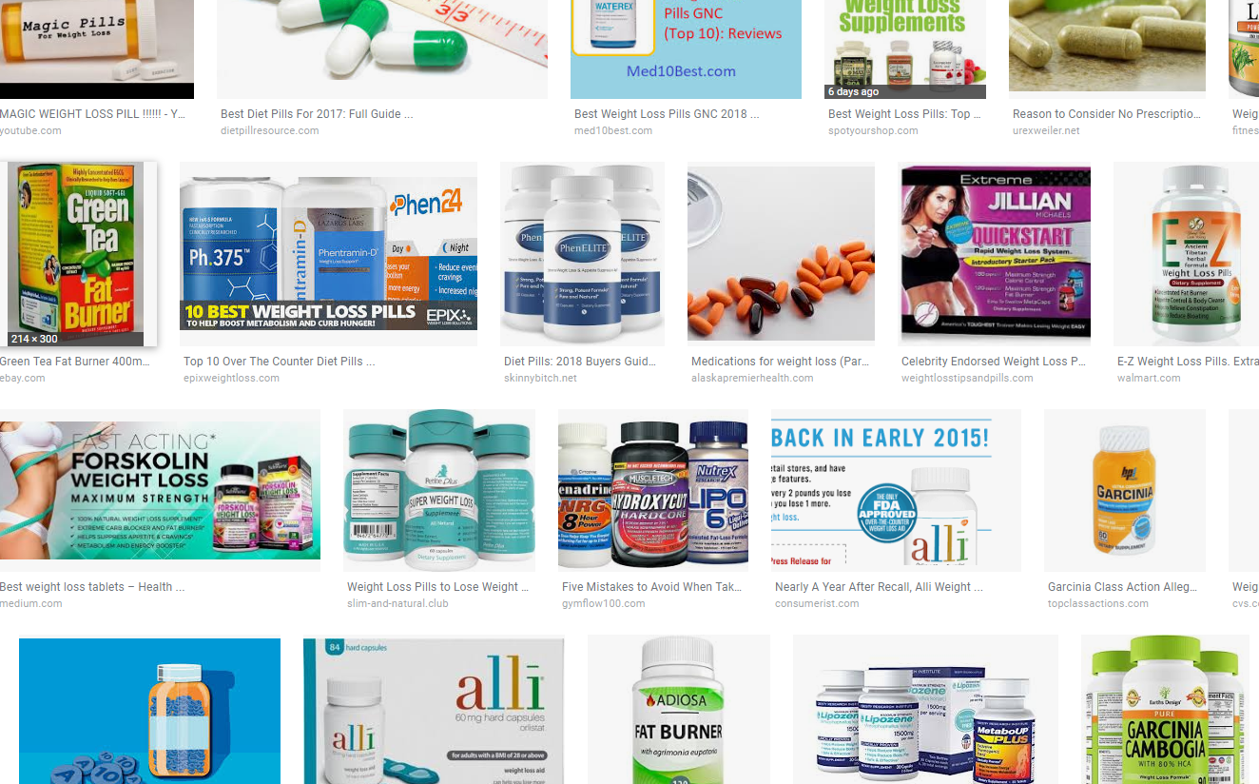
Unfortunately not
Magic bullet

Slide 7
Methods of prospecting
Fanatical Prospecting
Knocking on doors
Networking
Working the phone
Colleagues
Asking for referrals
Social outlets, i.e. LinkedIn
Would you place your retirement into only 1 fund?

Slide 9
In God we trust, everyone else we follow up on.
Jeb Blount

Slide 10
7 principles
Fanatical Prospecting
Optimistic, Enthusiastic
Competitive
Confident
Relentless
Thirsty for Knowledge
Systematic and Efficient
Adaptive, Adoptive, Adept

Slide 11
Make it a priority
Scheduling prospecting
Consider blocking your day into chunks of time with specific goals
Golden hours exclusive to prospecting
What’s an achievable goal?

Slide 12
Virtual selling
Selling in todays environment

Slide 13
Myths
Virtual Selling
What it is not:
Face-to-face vs. Virtual Selling
Revolutionizing the way we sell

Slide 14
defined
Virtual Selling
What it is:
Leveraging virtual communications channels in place of physical, face-to-face interactions
WE ALREADY USE THESE CHANNELS!

Slide 15
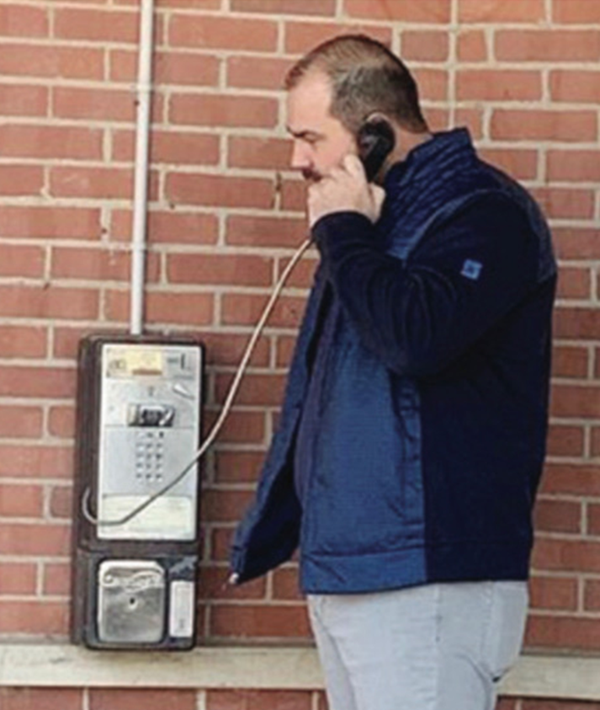
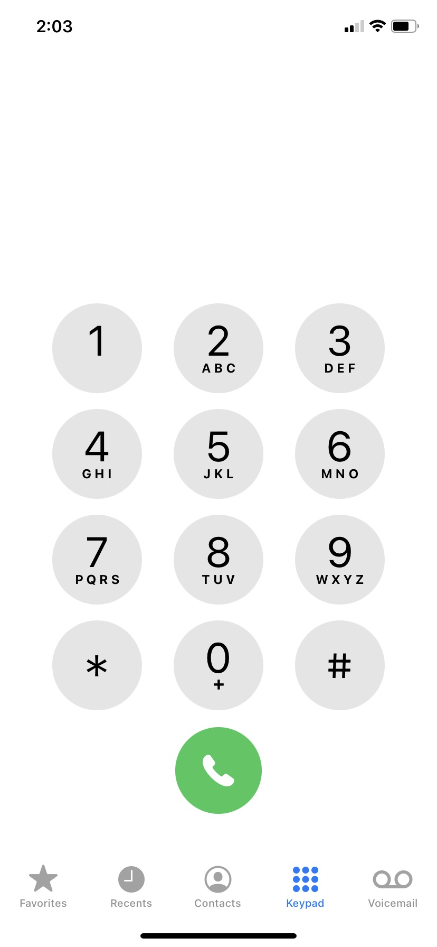
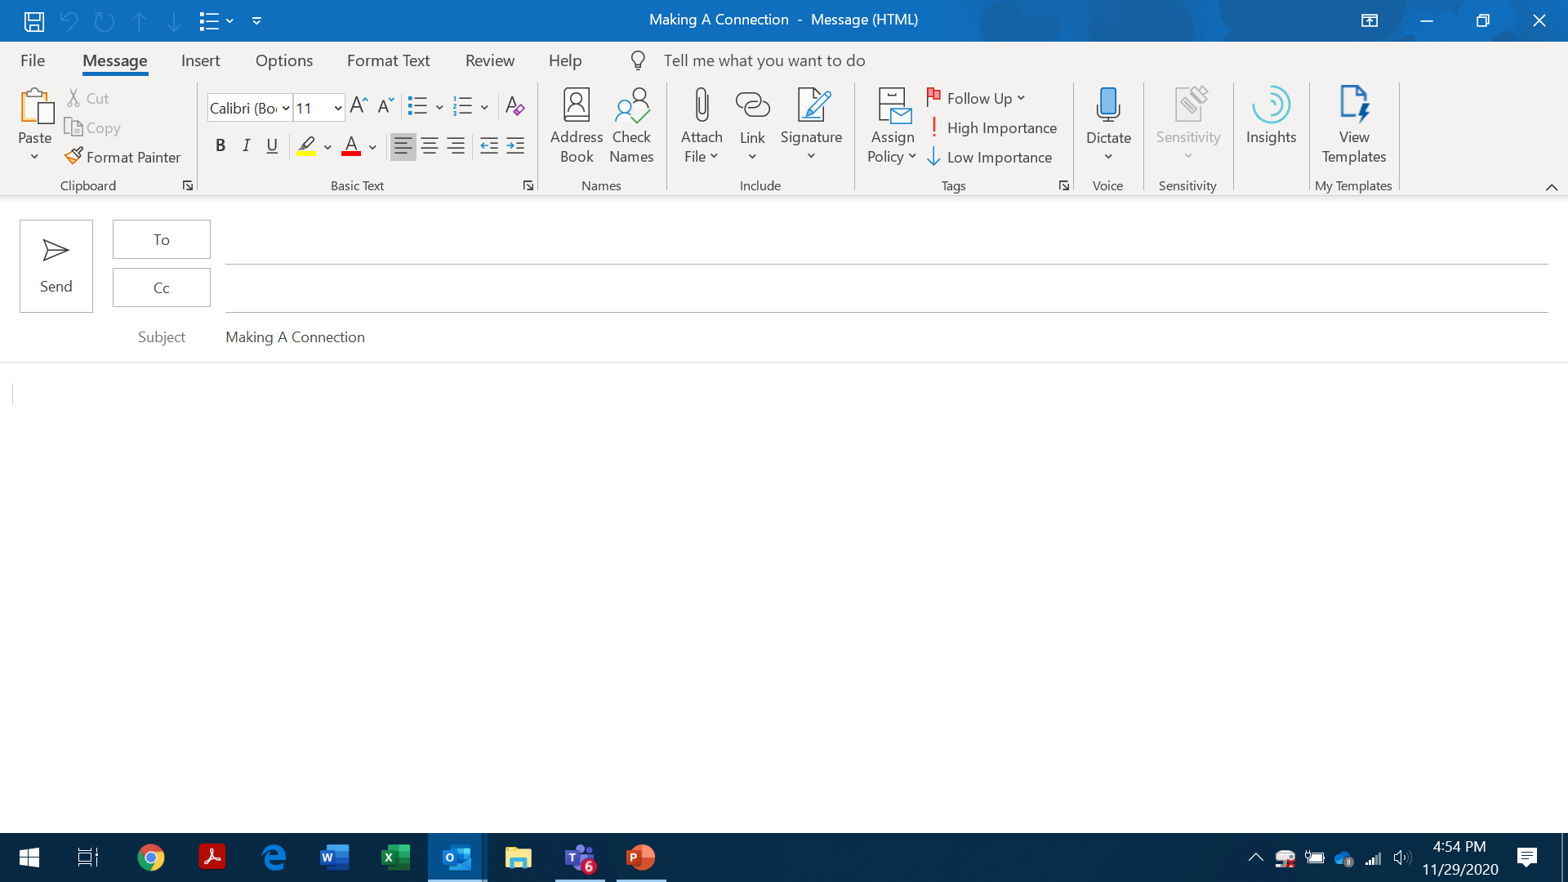
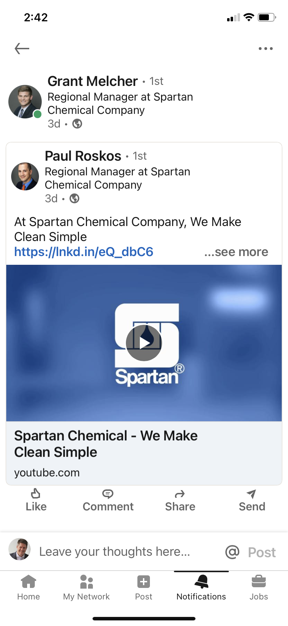
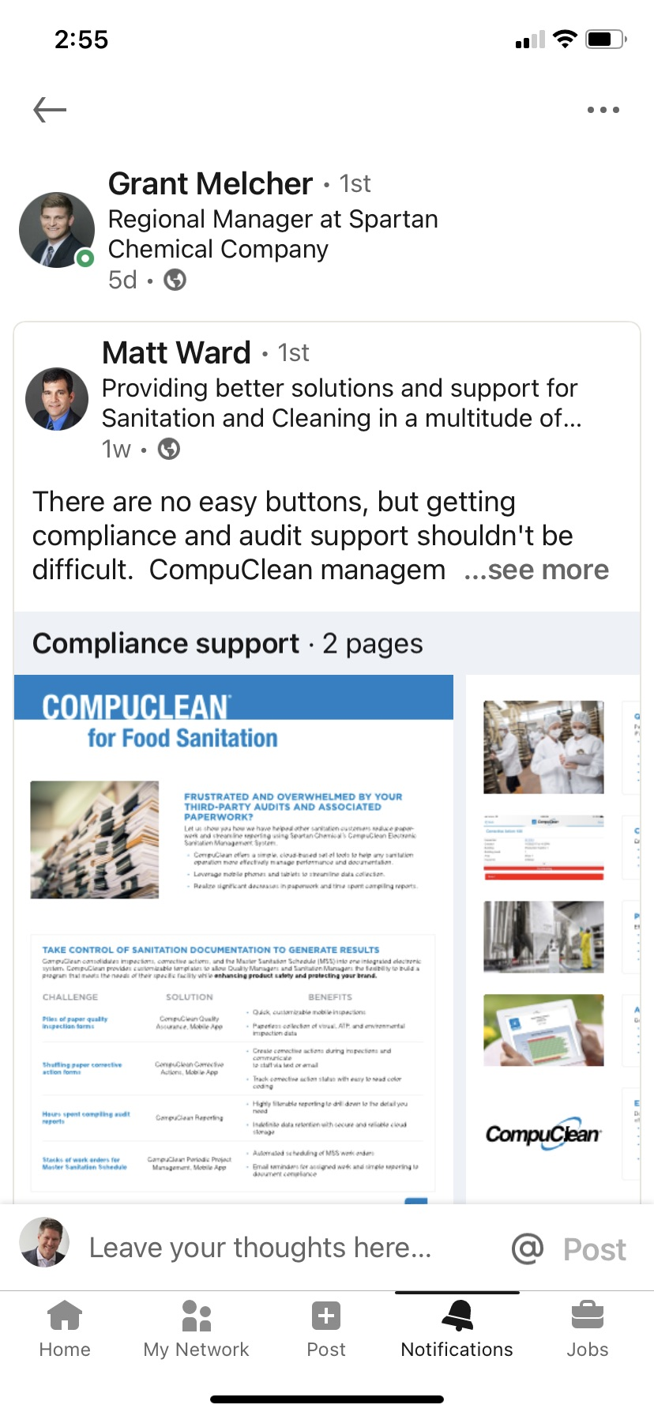
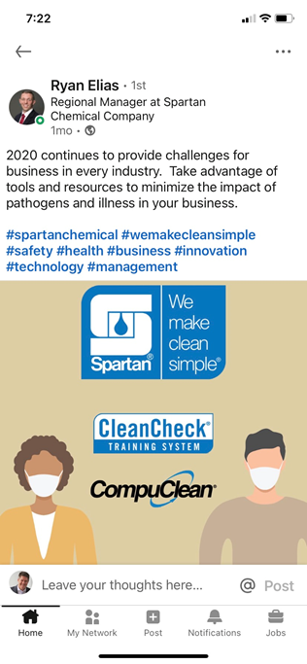
channels
virtual communication
Phone, email
Social Media
Video

Slide 16
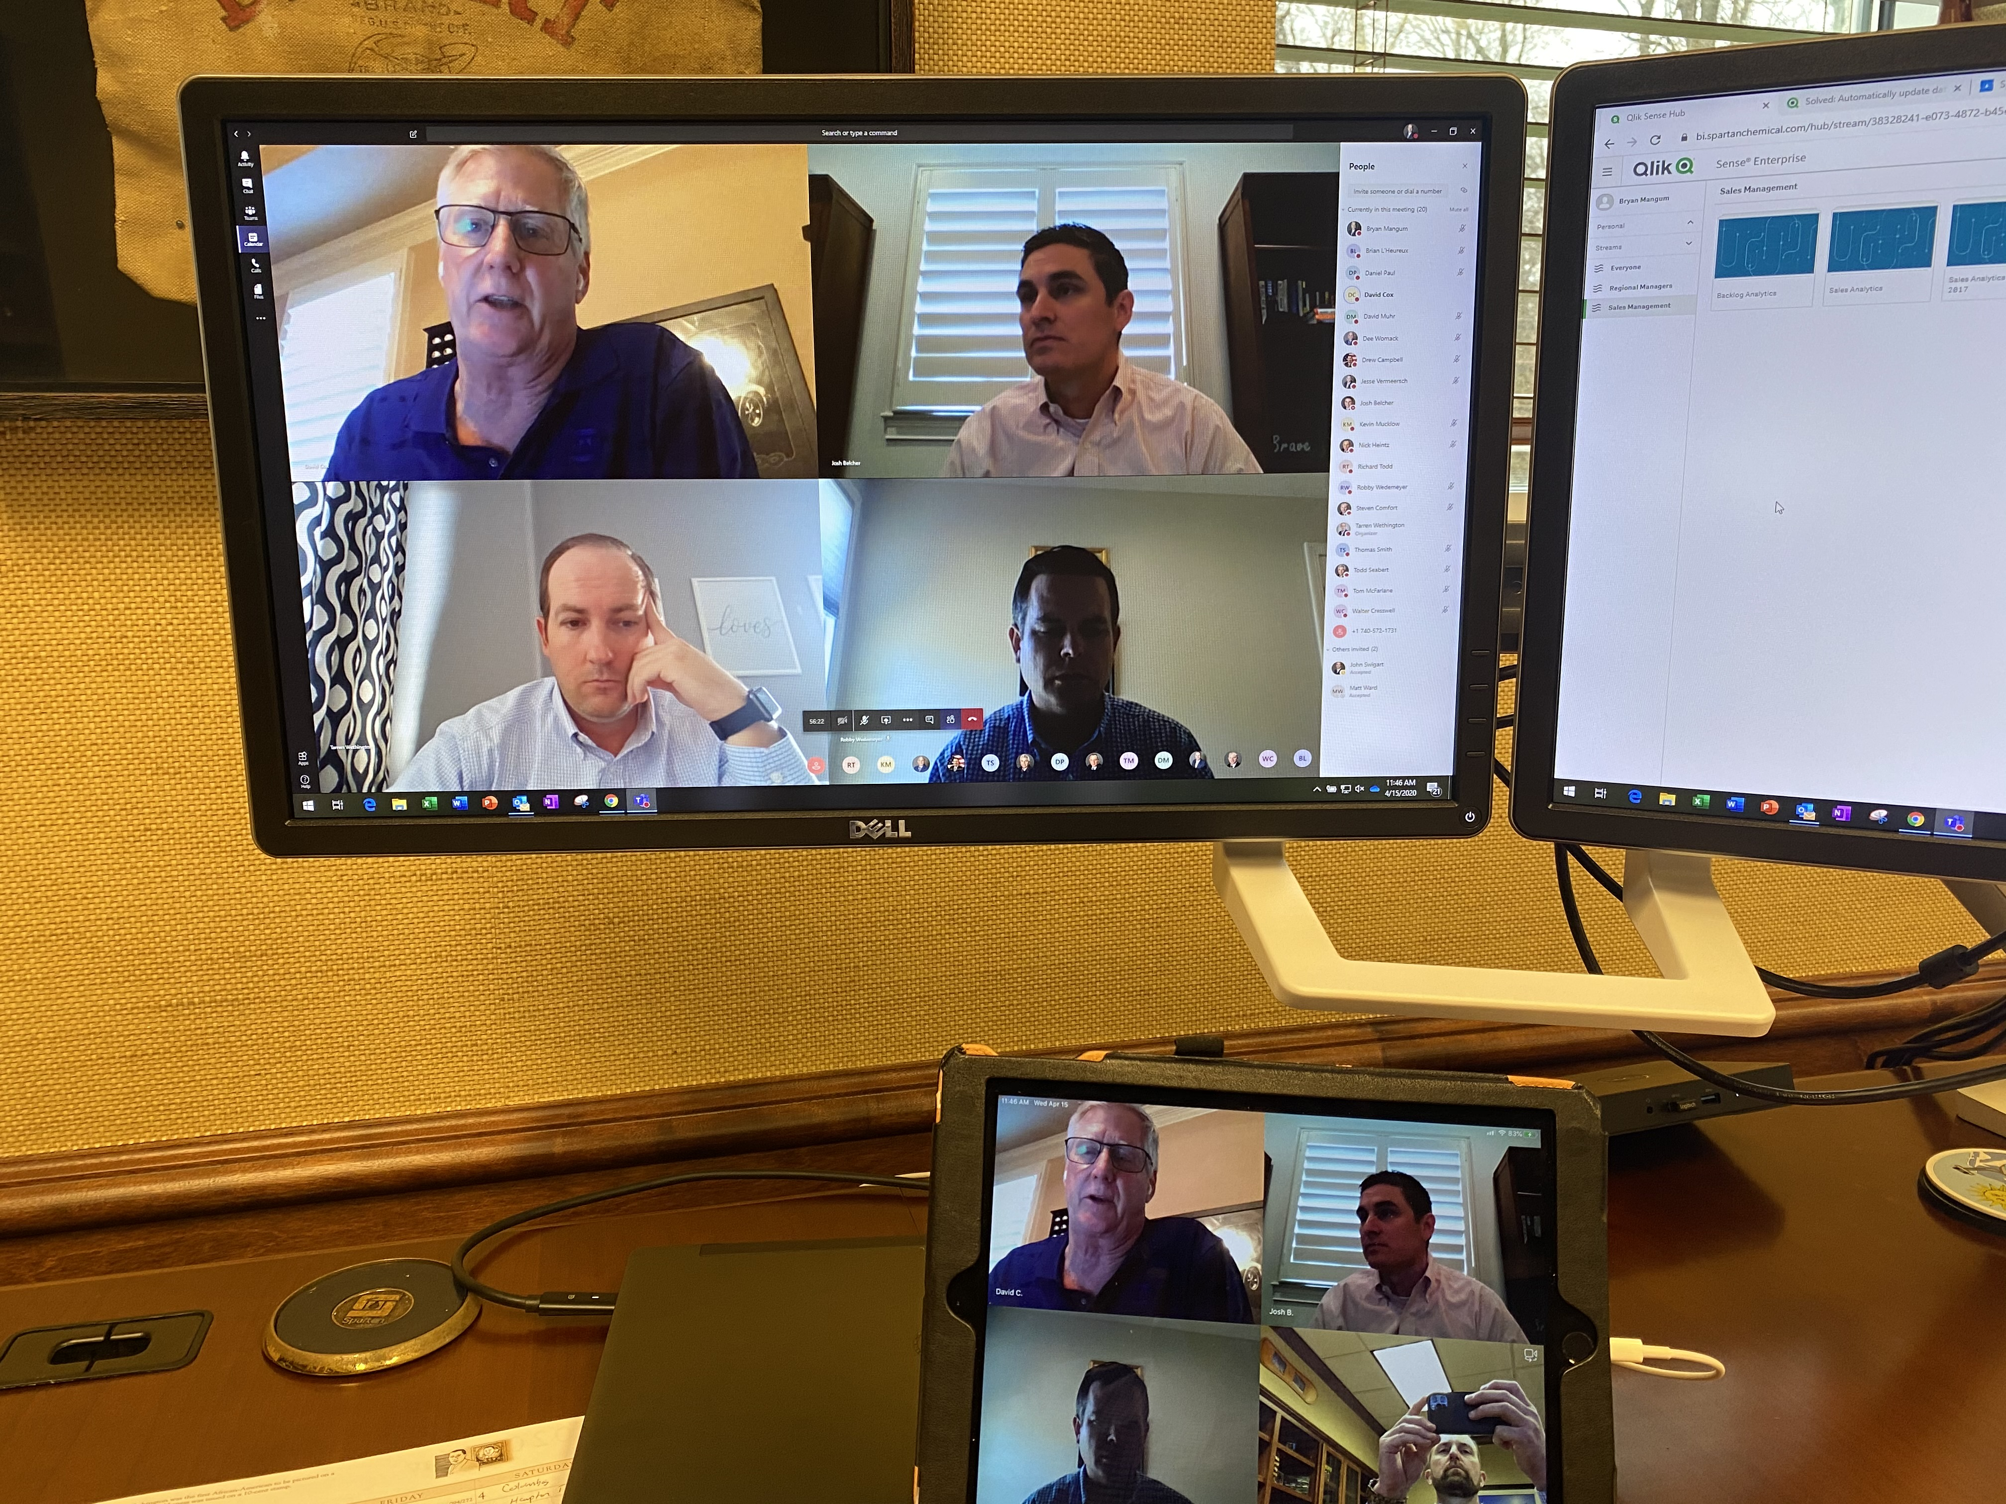
defined
Virtual Selling
Are we properly prepared
Lighting
Camera
Microphone
Backdrop
Familiar with software
Background noise
Dressed appropriately
Remember- you are on stage

Slide 17
Improving your effectiveness

Slide 18
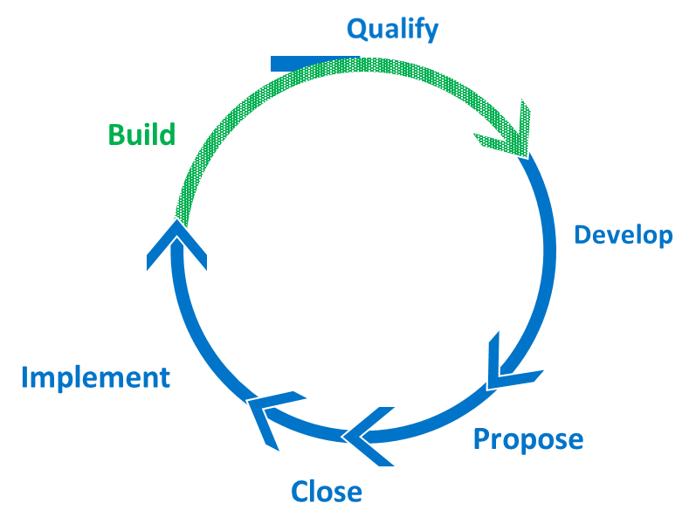
Improve your virtual effectiveness
Three key areas
Engaging Prospects in the pipeline
Identifying, targeting, and qualifying
Advancing Opportunities
Initial Meetings, Development, Demos, Presenting Proposals, and Closing
Servicing, Expanding, and Growing Existing Accounts
On-boarding, Building, and Protecting Relationships
Sales Process

Slide 19
Improve your Virtual effectiveness
Things to consider
Where can you be more effective?
Which types of communication channels are most effective at each stage of the selling process?
When should meetings be face-to-face?
When should you use video vs. phone?
How should you deploy social media and video messaging?
What is the appropriate use of email in the sales process?
Sales Process

Slide 20
Sales cadence
Engaging Prospects

Slide 21
Step 1
Step 2
Step 3
Identify Account
Connect On Linkedin
Send In-mail
Send Email
Step 6
Step 5
Step 4
Call and Voicemail
Video Email and Linkedin Tag
Phone Call and Email Follow Up
Step 7
Step 8
Step 9
Linkedin Tag
Final Call and Email
Disqualify Lead or move to Long Term Cadence
Notes:
This template was inserted from Power-user, the productivity add-in for PowerPoint, Excel and Word.
Get thousands of templates, icons, maps, diagrams and charts with Power-user. Visit https://www.powerusersoftwares.com/!

Slide 22
Sales navigator
Using Social Media to Prospect

Slide 23
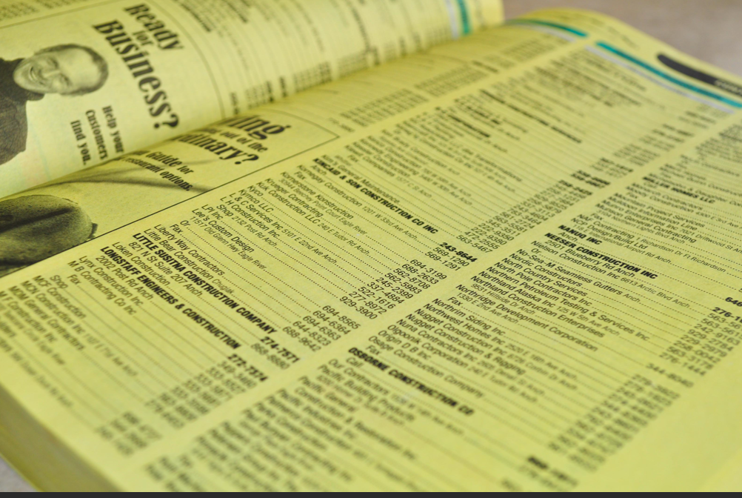
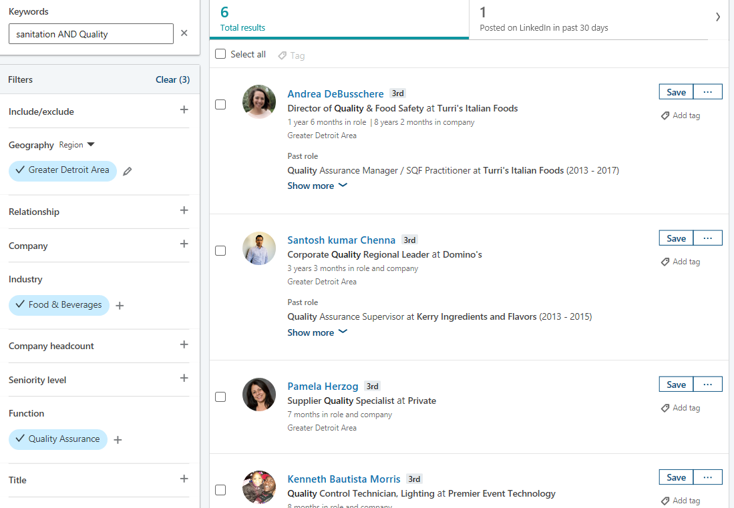
Social selling
Sales Navigator
Yellow pages vs Navigator

Slide 24
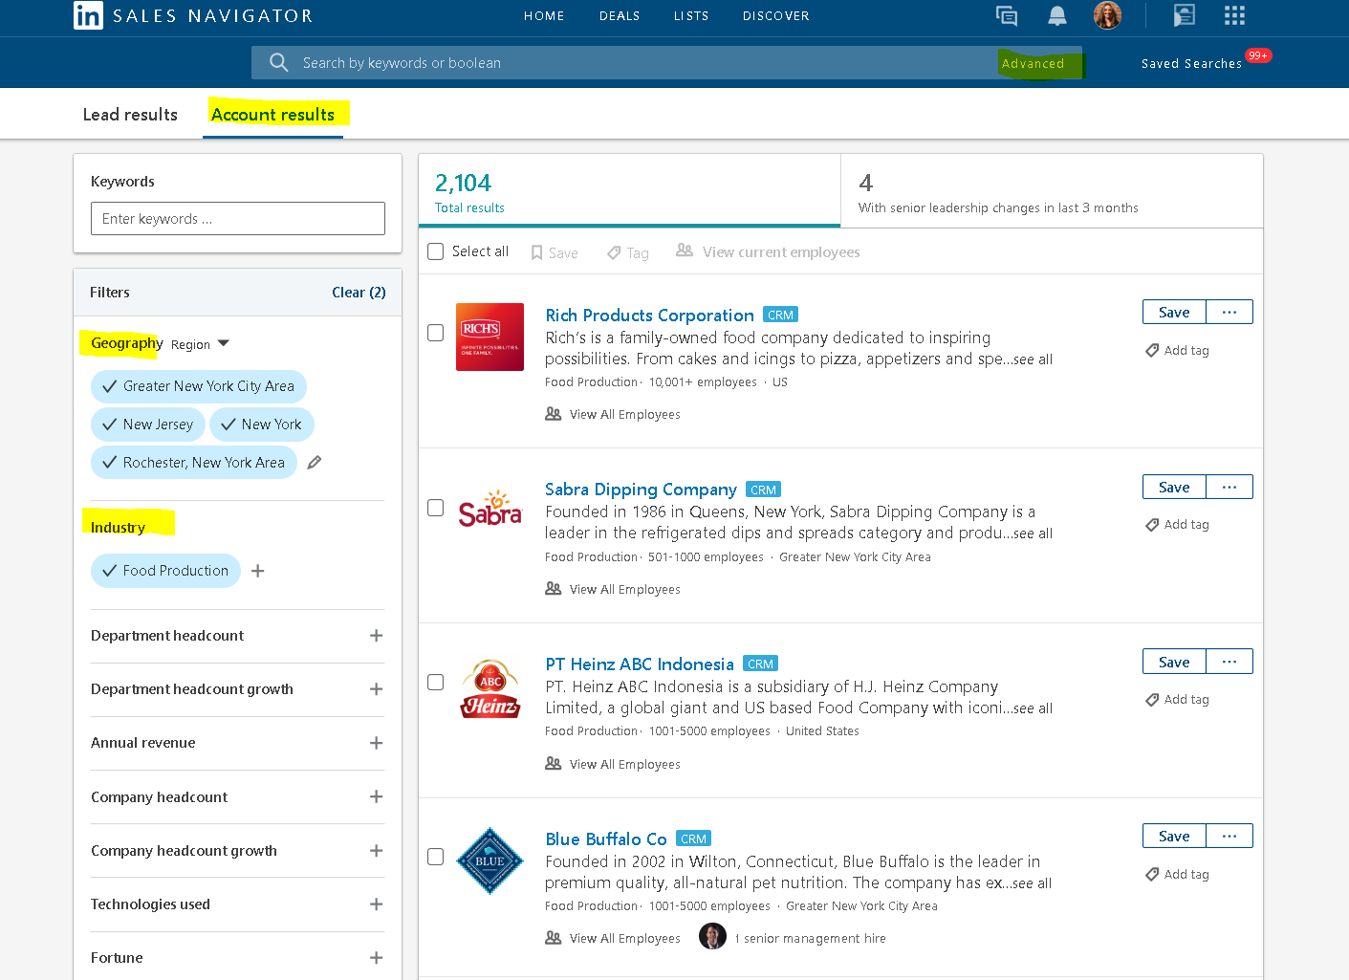
Deal Sourcing: Identify Target Accounts
Tip: You can work with the Spartan RM to scrub your target list.

Slide 25
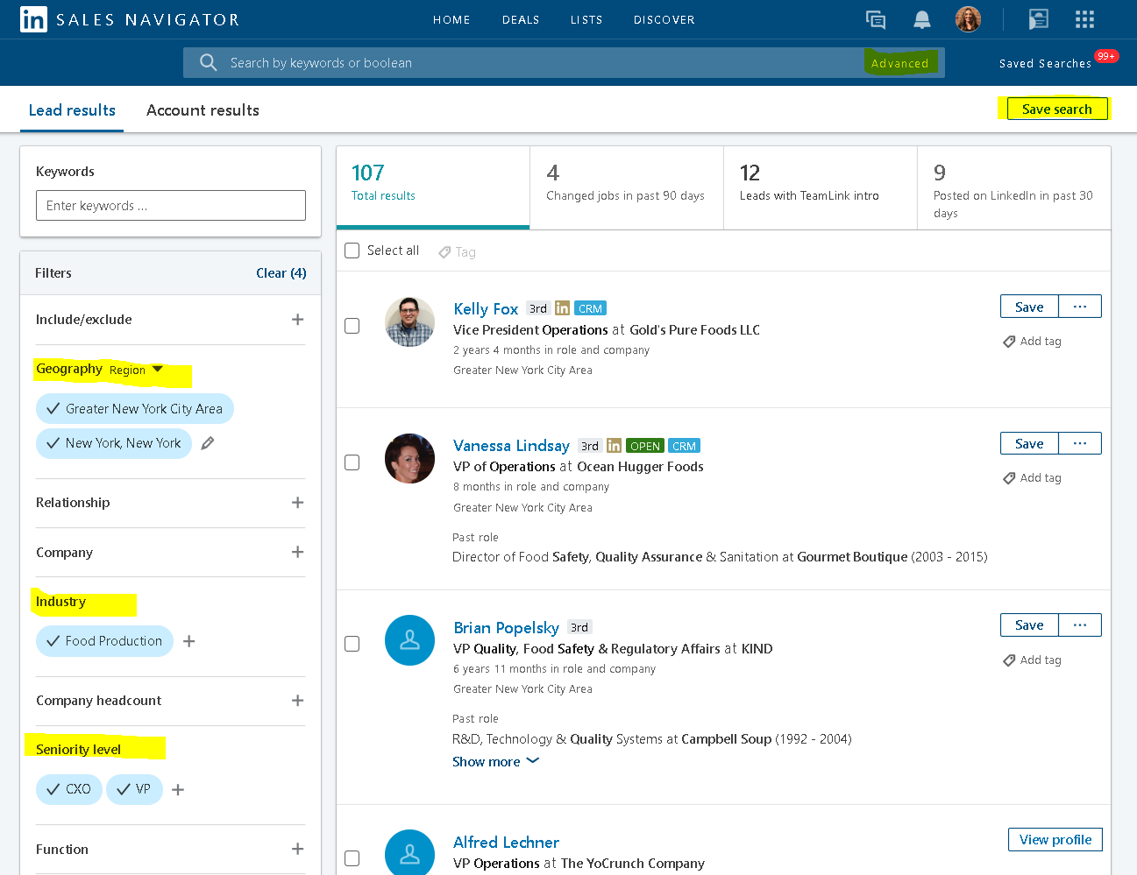
Deal Sourcing: Identify Target Leads in your territory

Slide 26
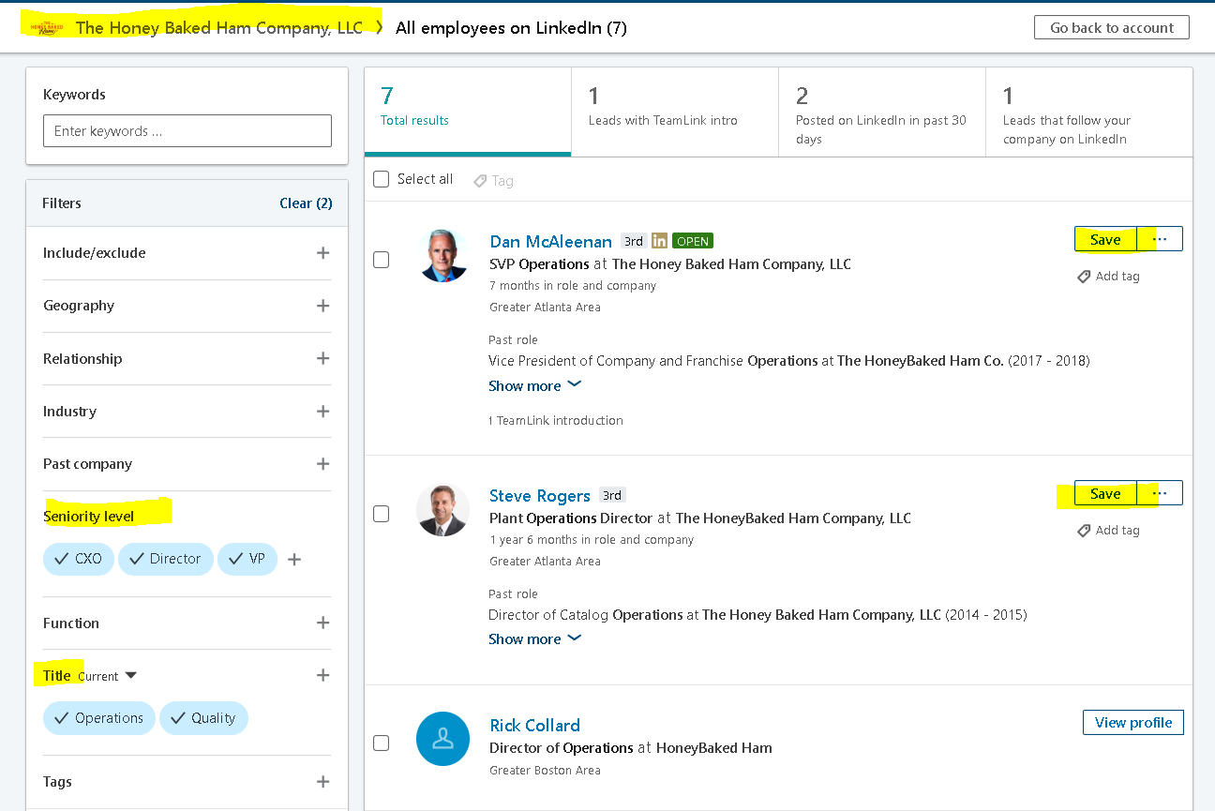
Identify the ENTIRE Buying Committee within your target accounts
Remember: The #1 reason why reps lose out on deals is because they are missing critical players.
On average, 6.8 people are involved in B2B buying decisions today.

Slide 27
The more I practice, the better I get!
Arnold Palmer

Slide 28
Sales call defined
Pre-Call
Preparation
Outline of call
Opening
Elevator Speech
Positioning yourself
Investigating
Situation
Problem
Implication
Need Pay Off
Demonstrating Capability
Solution to customer problem
Presentation
Obtaining Commitment
Gaining agreement to implementation

Slide 29
process
Qualified Leads
Establish Relationship
Deliver and Follow up
Understand
Requirements
Discovery
Breakdown occurs
Sale Cycle
Close the Deal
Propose Solution
Negotiate
Demonstrate Capability

Slide 30
decoded
Opening Stage
Elevator Speech
How to get the call off to a good start
A strong opening is critical – only one chance at a first impression
Introduction
How to properly introduce yourself
What's pertinent
Company overview
Simply highlights who we are, what we do, how we benefit others
Value proposition
Clear statement of the tangible results a customer gets from using your products
A couple sentences – about 10-15 seconds long
An elevator speech is a short, 1-2 sentence statement that defines who you work with (target market) and the general area in which you help them.

Slide 31
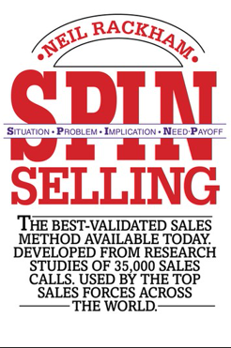
decoded
Investigating stage
How best do we conduct an investigation?
Ask good questions
What types of questions do we ask?
Open vs. Closed
Purpose of which is to
Uncover
Clarify
Develop buyer needs
The Huthwaite group has defined 4 distinct question types.

Slide 32
Section 1:
Situation
Section 2:
Problem
Section 3:
Implication
Section 4:
Need-Payoff

Slide 33
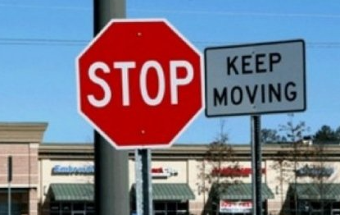
Defined
Situation
What’s a Situation Question
Basic questions
Background
Facts about the buyer’s existing situation
Not powerful – helpful to you, not for the customer
What floor finish do you currently use?
Who is your current chemical supplier?

Slide 34
Defined
problem
What’s a Problem Question
Asked to uncover
A problem
A difficulty
A dissatisfaction
People buy if they have a need.
Needs are generated via a problem or dissatisfaction.
The clearer and more explicit the need, the more likely they are to buy.

Slide 35
Defined
problem
Why a Problem Question
Reveal the buyer’s Implied Needs
Clarify the buyer’s difficulties and dissatisfactions
Gain shared understanding of the buyer’s problems
Typically asked by experienced sellers
Must uncover a problem you can solve – so you have something useful to offer the customer
Provides the data you need to build the sale

Slide 36
Defined
problem
Examples
What is your turnover rate?
How do you handle foul odor in your restrooms?
How do you conduct quality inspections?
What would you like to improve about your training process?
How satisfied are you with the response time of your current provider?
How many different SKUs do you utilize for basic cleaning?
How much do you spend on freight?

Slide 37
Defined
problem
Planning Problem Questions
Product | Problems we offer a superior solution to | Verticals
Clean by Peroxy | Too many SKUs | Education accounts
Sure Step | Slippery floors, No time to rinse | Dietary
Lite’n Foamy | Spend is out of control | BSCs
ecore | Environmental concerns | Commercial real estate
Profect HP | Accelerated kill claims | Healthcare

Slide 38
Defined
implication
What’s an Implication Question
Asks about the
Consequences
Effects
Implications
They help you sell by building the seriousness of the buyer’s problem so it becomes actionable.

Slide 39
Defined
implication
Problem questions focus inside the problem.
Implication questions focus outside the problem.
Potential Problem
Why
Problem
Does that cause
How often
Could lead to
Potential
Problem
Where
Increase the pain by extending the seriousness of the problem.

Slide 40
Defined
implication
Examples
What could a listeria outbreak mean to your brand?
How has staff turnover affected your local clientele?
What becomes of your quality inspections once you file them in the drawer?
How do you think the odors from the grease trap has affected your business?
What would a slip and fall cost your firm?
How has the hand mixing of chemicals impacted worker safety?

Slide 41
Defined
implication
Clear Problem
Desire for a
Solution
Implication of a
Forming Good Implication Questions
Planning
Not automatic – better executed if planned ahead of time
Bring urgency to the problem
Business knowledge
Why is a certain problem important to the buyer?
How that problem impacts the buyer’s business
Monetize the problem
Application knowledge
Understanding the problems our products solve
Key to knowing what needs to develop

Slide 42
Defined
Need-payoff
What’s a Need-Payoff Question
Value
Importance
Usefulness of the solution
They help you sell by increasing the attractiveness of a solution.

Slide 43
Defined
Need-payoff
Examples
How much would this program save you?
How could a web-based training system help your team?
How could our dilution control system increase workplace safety?
How will implementing a quality assurance program increase the cleanliness of your facility?
Why is that important to you?
What other benefits could you foresee by reducing SKUs?
Plan different levels of Need-Payoff questions
Identify “How useful would it be to implement an organized training system?”
Clarify “How important is the onboarding of new hires to your organization?”
Extend “Would Clean Check free up your management team to be more productive?”
The ICE system

Slide 44
People don’t care how much you know until they know how much you care.
Theodore Roosevelt

Slide 45
Defining critical business needs
Understanding customers
What are Critical Business Needs?
Definition: A Critical Business Need (verb) is a required action that is essential to the operation of a business (or job function)
Examples: To improve, to reduce, to enhance, to address, to integrate, to boost, …
What common needs do customers have?
Identity of 5 universal categories

Slide 46
B – BUILDING image
L – LABOR READINESS
O – OPERATIONAL Efficiency
C – COST CONTAINMENT
S – SAFETY / SUSTAINABILITY

Slide 47
Building image
Critical business needs
Definition
An overall impression that’s conveyed to visitors / occupants
Examples
Enhance first impression areas
Improve restroom experience
Improve carpeting appearance
Boost gloss level of resilient floors
Improve fragrance throughout the facility
Reduction of haze on glass surfaces

Slide 48
Labor readiness
Critical business needs
Definition
State of preparedness to carry out a given set of tasks
Examples
Implement an appropriate LMS
Teaching critical skills
Establish a custodial management program
Arm employees with all the tools to succeed
Build employee confidence

Slide 49
Operational Efficiency
Critical business needs
Definition
Ability to deliver services in the most cost effective manner while keeping quality high
Examples
Integrating a custodial management program
Improve employee productivity
Right size employee-to-task ratio
Reduce expense as it relates to productivity
Delivery requirements / logistics
Operationally excellent

Slide 50
Cost containment
Critical business needs
Definition
Changes that drive containment or savings in product, employee, or activity costs
Examples
Reduction in supply costs
Implement a dilution control system
Implement a multi-use product for SKU reduction
Utilize super concentrates / bulk systems
Manage total procurement cost
Rationalize vendors

Slide 51
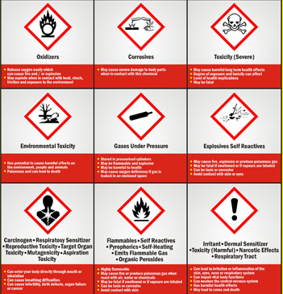
safety
Critical business needs
Definition
Occupant / Worker / Food safety and wellness in the work place
Examples
Develop best practices
Define SOPs
Hazard communication
Elimination of potential pathogens
Protection of the brand
Understanding critical control points

Slide 52
Sustainability
Critical business needs
Definition
Conserve resources; decisions made based on environmental impact; indoor / outdoor
Examples
Implement LEED program
Implement a sustainability program
Use safer choices
Reduce the use of dangerous chemicals

Slide 53
B – BUILDING image
L – LABOR READINESS
O – OPERATIONAL Efficiency
C – COST CONTAINMENT
S – SAFETY / SUSTAINABILITY

Slide 54
How to apply the use of bloc-s

Slide 55
Defined
Bloc-s questions
As it relates to your facility
What are some of your most critical business needs?
How does the physical state of your facility impact your clients?
How important is the efficiency of your cleaning staff?
In what specific areas are you tasked to reduce spending?
What are your goals in regards to sustainability?
What concerns do you have in regards to employee safety?
If you were to rank these 5 categories, which two are your biggest priorities?
What impact could a custodial management program have on your management team?
What steps are you taking to…?
A pre-question statement - “We find that sustainability is still relevant. What…?”

Slide 56
Notes:
To address the challenges and put ourselves in the best position to capture a prospects attention we utilize a sales cadence that implements many different mediums of making contact while having a clear and dynamic message presented from beginning to end of the process.

Slide 57
Personality profiles

Slide 58
Types
Personality profiles
Created by Dr. William Marston

Slide 59
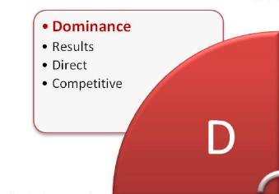
Dominance
Personality profiles
THEY
Tell you things
Speak loudly
Quick movements
Direct eye contact
Lean toward you
Gesture a lot
Serious
Finish your sentences
YOU
Get to the point
Don’t waste time
Put everything in writing
Summarize benefits

Slide 60
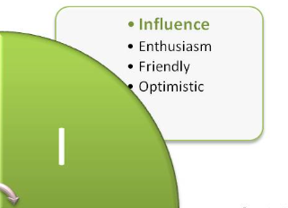
Influence
Personality profiles
THEY
Personal questions
Friendly
May touch you
Many hand movements
YOU
Present big pictures
Use emotional benefits
Use reassuring close

Slide 61
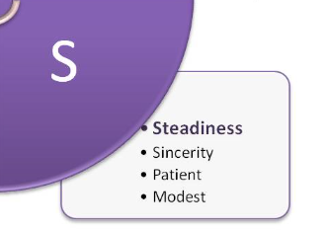
Steadiness
Personality profiles
THEY
Like to build relationships
Friendly & likeable
Traditional attitudes
Make careful decisions
Somewhat “wishy washy”
YOU
Be friendly
Don’t pressure
Stress contractual benefits
Allow them to include others in decision

Slide 62
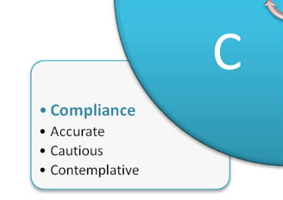
Compliance
Personality profiles
THEY
Like facts & details
Money & numbers
Neat & organized
Time conscious
Risk aversive
YOU
Let them feel they are right
Give them facts first
Stress rational reason
Compliment regularly
Use quick, direct close

Slide 63
disc

Slide 64
53% of loyalty is a result of not what you sell, but how you sell it

Slide 65
Pre-Call Plan
Sales call defined
Distributor/ Rep Name | Date/ Time
Account Name
Customer Contacts / Roles
Stage – Qualify – Develop – Propose – Close
What are we going to accomplish on call?
How will the call open?
How will I build rapport?
What do I need to know about customer?
What problems could exist?
Required resources for the call
Following the call – Next steps?

Slide 66
Turning process into real life
Qualify
Develop
Establish Relationship
Understand
Requirements
Close
Propose
Close the Deal
Negotiate
Customer Solution
Demonstrate Capability

Slide 67
AFTO – ABC – CRM – B2B – map
Don’t over complicate it

Slide 68
Thank you

